Slide 1

Jawaharlal Nehru Technological University -Jagityal (JNTU-J)
Kondagattu, Jagityal, Karimnagar Dist.
Cloud Computing Course (R16 Syllabus)
Cloud Services – Unit-IV
by
Dr. P. Sammulal, Professor
Department of
Computer Science & Engineering(CSE)

Slide 2
Jawaharlal Nehru Technological University – Jagityal (JNTU –J)
Overview of Unit-IV
What are Cloud Services?
Introduction of 3 Services of Cloud
Infrastructure as a Service (IaaS)
    Basic Services of IaaS
    Characteristics of IaaS
    Suitability of IaaS
    Pros and Cons of IaaS
    Details of IaaS Providers
Cloud Computing – Cloud Services – Unit-IV

Slide 3
Jawaharlal Nehru Technological University – Jagityal (JNTU –J)
Overview of Unit-IV
Platform as a Service (PaaS)
    Basic Services of PaaS
    Characteristics of PaaS
    Suitability of PaaS
    Pros and Cons of PaaS
    Details of PaaS Providers
Cloud Computing – Cloud Services – Unit-IV

Slide 4
Jawaharlal Nehru Technological University – Jagityal (JNTU –J)
Overview of Unit-IV
Other Services of Cloud
Software as a Service (SaaS)
    Basic Services of SaaS
    Characteristics of SaaS
    Suitability of SaaS
    Pros and Cons of SaaS
    Details of SaaS Providers
    Other Services of Cloud
Cloud Computing – Cloud Services – Unit-IV

Slide 5
Jawaharlal Nehru Technological University – Jagityal (JNTU –J)
What are Basic Cloud Services?
Cloud Computing – Cloud Services – Unit-IV

Slide 6
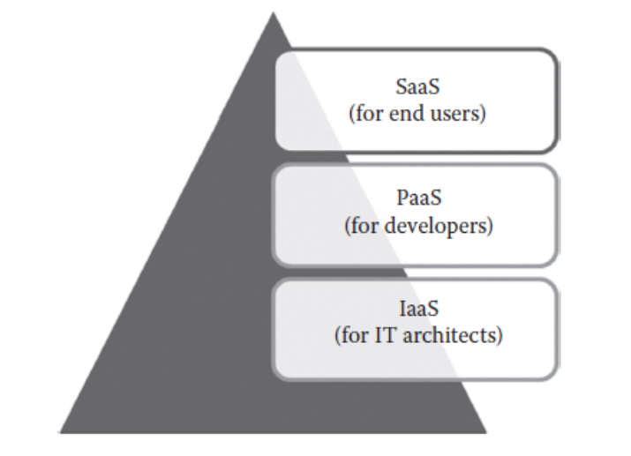
Jawaharlal Nehru Technological University – Jagityal (JNTU –J)
Cloud Basic Services
Cloud is a collection of resources collected from different places connected over Internet
Cloud OS makes all resources to work together
Cloud provides 3 basic services
    IaaS
    PaaS
    SaaS
Cloud Computing – Cloud Services – Unit-IV

Slide 7
Jawaharlal Nehru Technological University – Jagityal (JNTU –J)
Infrastructure as a Service(IaaS)
Cloud-IaaS provides its infrastructure as a service
Infrastructure includes computers, servers, storage, networks, etc.
Target users for this service is IT Architects
IT Architects are responsible for
    Installation & configuration of OS
    Creating & configuring Development platform
    Development, installation & testing of applications
Cloud Computing – Cloud Services – Unit-IV

Slide 8
Jawaharlal Nehru Technological University – Jagityal (JNTU –J)
Infrastructure as a Service(IaaS)
IT Architects are exempted from maintenance of cloud infrastructure
Cloud service provider is responsible for
    Maintenance and operation of cloud infrastructure
    IaaS service is offered from cloud data centers
    End-user can access it through WCLI or APIs
Cloud Computing – Cloud Services – Unit-IV

Slide 9
Jawaharlal Nehru Technological University – Jagityal (JNTU –J)
Infrastructure as a Service(IaaS)
    Cloud-IaaS providers in the market
        Amazon Web Services
        Google Compute Engine
        Microsoft Azure Service
        OpenStack
        Open Nebula
        Apache CloudStack
        Eucalyptus
Cloud Computing – Cloud Services – Unit-IV

Slide 10
Jawaharlal Nehru Technological University – Jagityal (JNTU –J)
Platform as a Service(PaaS)
Cloud-PaaS provides OS platform as a service to the end-user
The platform is configured by the service provider.
Target users for this service are Application Developers
Developer is responsible for
    Development, installation & testing of applications
Cloud Computing – Cloud Services – Unit-IV

Slide 11
Jawaharlal Nehru Technological University – Jagityal (JNTU –J)
Platform as a Service(PaaS)
Developers are exempted from maintenance of cloud infrastructure, installation and configuration of OS
Cloud service provider is responsible for
    Maintenance and operation of cloud infrastructure
    installation and configuration of OS
    PaaS service is offered from hosted and managed cloud by the service provider
    End-user access it through WCLI or WGUI
Cloud Computing – Cloud Services – Unit-IV

Slide 12
Jawaharlal Nehru Technological University – Jagityal (JNTU –J)
Platform as a Service(PaaS)
    Cloud-PaaS providers in the market
        Google App Engine
        Force.com
        Heroku
        Engine Yard
Cloud Computing – Cloud Services – Unit-IV

Slide 13
Jawaharlal Nehru Technological University – Jagityal (JNTU –J)
Software as a Service(SaaS)
Cloud-SaaS provides its applications as a service to the end-user
The application is configured by the service provider.
Target users for this service is end-user who have little knowledge on computers
End-User is responsible for nothing except using application
Cloud Computing – Cloud Services – Unit-IV

Slide 14
Jawaharlal Nehru Technological University – Jagityal (JNTU –J)
Software as a Service(SaaS)
End-user are exempted from everything
Cloud service provider is responsible for
    Maintenance and operation of cloud infrastructure
    installation and configuration of OS
    Development, installation & testing of applications
    SaaS service is offered from hosted and managed cloud by the service provider
    End-user access it through web browser on a thin-client system
Cloud Computing – Cloud Services – Unit-IV

Slide 15
Jawaharlal Nehru Technological University – Jagityal (JNTU –J)
Software as a Service(SaaS)
    Cloud-SaaS providers in the market
        Google App
        Microsoft Office 365
        Salesforce
        SAP
Cloud Computing – Cloud Services – Unit-IV

Slide 16
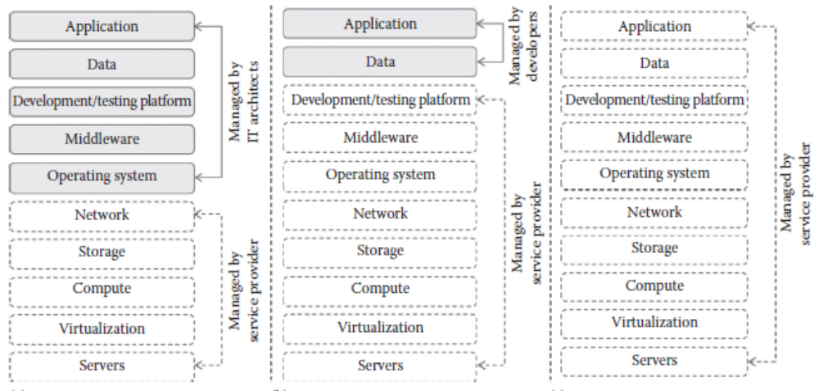
Jawaharlal Nehru Technological University – Jagityal (JNTU –J)
IaaS, PaaS and SaaS
    Each service is targeted for some people
    Based on service subscription, responsibilities of the end-user and service provider will change
Cloud Computing – Cloud Services – Unit-IV

Slide 17
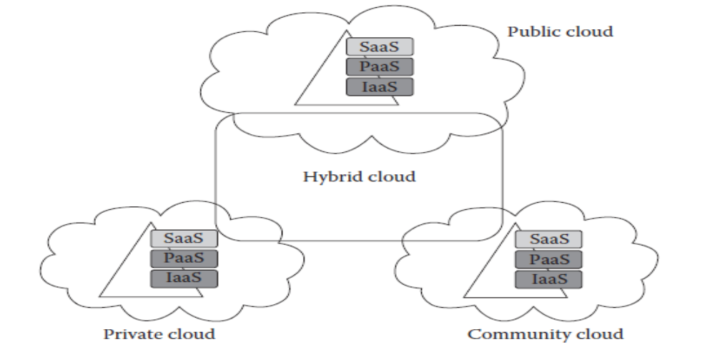
Jawaharlal Nehru Technological University – Jagityal (JNTU –J)
IaaS, PaaS and SaaS
    Each service can be delivered to the user using any deployment model of the cloud
Cloud Computing – Cloud Services – Unit-IV

Slide 18
Jawaharlal Nehru Technological University – Jagityal (JNTU –J)
Infrastructure as a Service(IaaS)
Cloud Computing – Cloud Services – Unit-IV

Slide 19
Jawaharlal Nehru Technological University – Jagityal (JNTU –J)
Infrastructure as a Service(IaaS)
Cloud-IaaS provides its infrastructure as a service
Infrastructure includes computers, servers, storage, networks, etc.
IaaS transforms these physical resources in to the virtual resources
Many instances of virtual resources are created from one physical resource
Cloud Computing – Cloud Services – Unit-IV

Slide 20
Jawaharlal Nehru Technological University – Jagityal (JNTU –J)
Infrastructure as a Service(IaaS)
Virtual resources are created using virtualization technology
Hypervisor plays an important role in virtualization
Hypervisor is a software
Virtual resources are used to create Virtual Machine(VM)
End-user accesses cloud resources in the form of VMs
Cloud Computing – Cloud Services – Unit-IV

Slide 21
Jawaharlal Nehru Technological University – Jagityal (JNTU –J)
Infrastructure as a Service(IaaS)
Each VM serves one user
Each VM is configured with different OS
End-User can select VM as per his requirement
VM can also be created by IT Architect as per his requirement
End-User can access only VM, user is not given direct access to the physical resources
Load balancer distributes load equally to all VMs
Cloud Computing – Cloud Services – Unit-IV

Slide 22
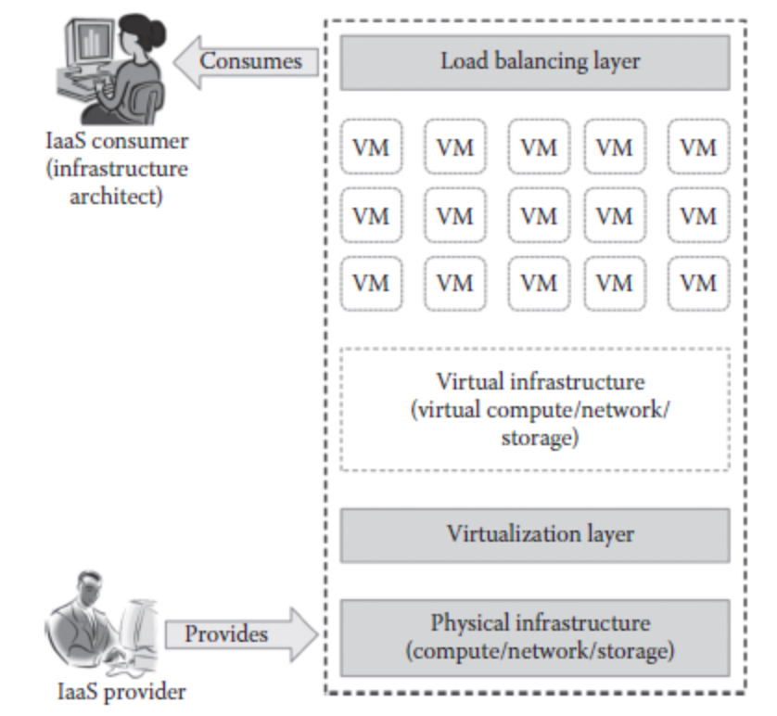
Jawaharlal Nehru Technological University – Jagityal (JNTU –J)
Infrastructure as a Service(IaaS)
The diagram shows how IaaS is providing services to end-user
Cloud Computing – Cloud Services – Unit-IV

Slide 23
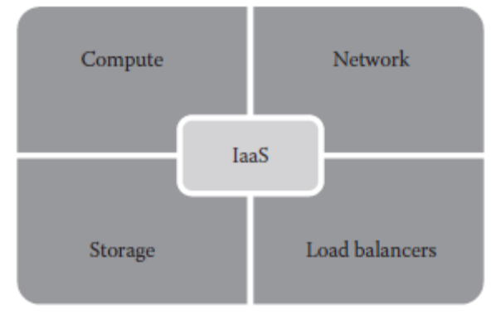
Jawaharlal Nehru Technological University – Jagityal (JNTU –J)
Infrastructure as a Service(IaaS)
a) 4- basic services of IaaS:-
IaaS provides 4 basic services to end-user
    Computing Service
    Storage Service
    Network Service
    Load Balancing Service
Cloud Computing – Cloud Services – Unit-IV

Slide 24
Jawaharlal Nehru Technological University – Jagityal (JNTU –J)
Infrastructure as a Service(IaaS)
    Computing Service:-
    Computing Service provides virtual CPUs, virtual Memory as service for supporting VMs
    Storage as a Service:-
    Storage as a Service (STaaS) is offered as a back-up service to the VMs to store its data
Cloud Computing – Cloud Services – Unit-IV

Slide 25
Jawaharlal Nehru Technological University – Jagityal (JNTU –J)
Infrastructure as a Service(IaaS)
    Network as a Service:-
    Network as a Service(NaaS) provides virtual routers, switches, hubs to the end-user
Load Balancers Service:-
Load Balancers are also offered as service to distribute the load equally to VMs
Cloud Computing – Cloud Services – Unit-IV

Slide 26
Jawaharlal Nehru Technological University – Jagityal (JNTU –J)
Infrastructure as a Service(IaaS)
    b) Characeristics of IaaS:-
    IaaS has its own characteristics in addition to the 5-essential characteristics of the cloud
        Web Access to the Resources
        Centralized Management or Control
        Elasticity or Dynamic Scaling
        Shared Resources
        Pre-Configured VMs
        Metered Service
Cloud Computing – Cloud Services – Unit-IV

Slide 27
Jawaharlal Nehru Technological University – Jagityal (JNTU –J)
Infrastructure as a Service(IaaS)
    c) Suitability of IaaS:-
    IaaS eventhough, it provides lot of benefits to the user and the organization, it can be used and can’t be used at some places
    Places where IaaS is suitable:-
        Unpredictable spikes in the usage of resources
        Limited capital investment
        Infrastructure need for short period
Cloud Computing – Cloud Services – Unit-IV

Slide 28
Jawaharlal Nehru Technological University – Jagityal (JNTU –J)
Infrastructure as a Service(IaaS)
    c) Suitability of IaaS:-
    Places where IaaS is not suitable:-
        Where company restrictions prevents hosting of data on 3rd party computers
        Where limited usage is there
        Where better performance is required
        Where more control on physical resources are required
Cloud Computing – Cloud Services – Unit-IV

Slide 29
Jawaharlal Nehru Technological University – Jagityal (JNTU –J)
Infrastructure as a Service(IaaS)
    d) Pros and Cons of IaaS:-
    IaaS, even though provides lot of benefits to the organizations by saving its money and reducing its TCO and increasing its ROI, it is having advantages and disadvantages
Cloud Computing – Cloud Services – Unit-IV

Slide 30
Jawaharlal Nehru Technological University – Jagityal (JNTU –J)
Infrastructure as a Service(IaaS)
    d) Pros and Cons of IaaS:-
    Advantages:-
        Pay-as-you-go model
        Elasticity
        Reduced TCO
        Better Resource utilization
        Increased ROI
        Support for Green IT
Cloud Computing – Cloud Services – Unit-IV

Slide 31
Jawaharlal Nehru Technological University – Jagityal (JNTU –J)
Infrastructure as a Service(IaaS)
    d) Pros and Cons of IaaS:-
    Disadvantages:-
        Security issues
        Performance issues
        Interoperability issues
Cloud Computing – Cloud Services – Unit-IV

Slide 32
Jawaharlal Nehru Technological University – Jagityal (JNTU –J)
Infrastructure as a Service(IaaS)
    e) IaaS providers:-
    Many IaaS providers are available in the market.
    IaaS Services offered using any of 4 deployment models
    User can select any one of the serivice providers based on their requirement and support given by the provider
Cloud Computing – Cloud Services – Unit-IV

Slide 33
Jawaharlal Nehru Technological University – Jagityal (JNTU –J)
Infrastructure as a Service(IaaS)
    e) IaaS providers:-
    Service providers details are viwed in terms of
        License
        Deployment model
        Host OS
        Guest OS and
        Hypervisor
Cloud Computing – Cloud Services – Unit-IV

Slide 34
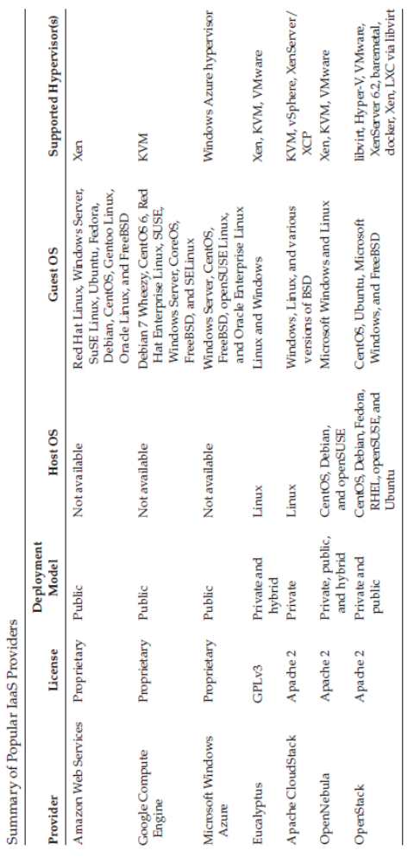
Jawaharlal Nehru Technological University – Jagityal (JNTU –J)
Infrastructure as a Service(IaaS)
    IaaS providers:-
    Service providers list
Cloud Computing – Cloud Services – Unit-IV

Slide 35
Jawaharlal Nehru Technological University – Jagityal (JNTU –J)
Platform as a Service(PaaS)
Cloud Computing – Cloud Services – Unit-IV

Slide 36
Jawaharlal Nehru Technological University – Jagityal (JNTU –J)
Platform as a Service(PaaS)
Cloud-PaaS provides its Operating System(OS) platform as a service to the user
Varieties of OSs are offered as service
Target end-users are Application Developers
Cloud Application Development Platform is completely different from Traditional IT Application Development Platform
Cloud Computing – Cloud Services – Unit-IV

Slide 37
Jawaharlal Nehru Technological University – Jagityal (JNTU –J)
Platform as a Service(PaaS)
Traditional IT Application Development Platform user has to work
    On stand-alone system
    One user at a time can work
    Limited resources for App. Development
    Online access is not possible
    All team members can’t work at a time
Cloud Computing – Cloud Services – Unit-IV

Slide 38
Jawaharlal Nehru Technological University – Jagityal (JNTU –J)
Platform as a Service(PaaS)
In a Cloud-PaaS Application Development Platform
    Collaborative platform is provided
    All team members can work at a time
    Many resources are provided for App. Development
    Online access is possible
    Team members need not be at one place
End-user can access Paas platform through WCLI or WGUI or APIs
Cloud Computing – Cloud Services – Unit-IV

Slide 39
Jawaharlal Nehru Technological University – Jagityal (JNTU –J)
Platform as a Service(PaaS)
End-user can access Paas platform through WCLI or WGUI or APIs
End-user can acces only virtual application development platform created by service provider
Paas converts local development into online development
Application Developer is exempted from resource maintenance, OS installations, configuring platform, etc.
Cloud Computing – Cloud Services – Unit-IV

Slide 40
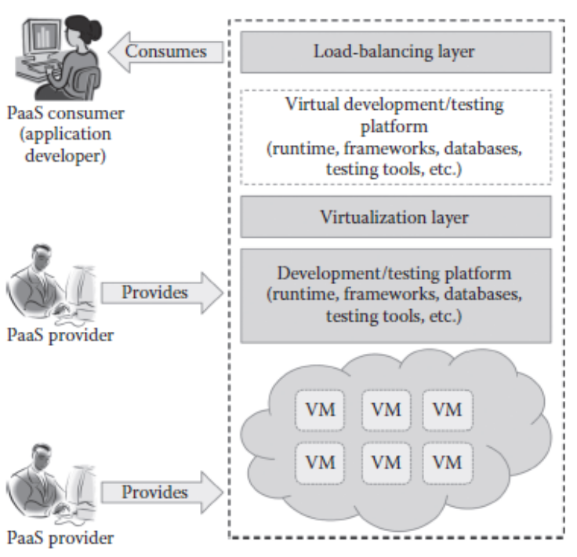
Jawaharlal Nehru Technological University – Jagityal (JNTU –J)
Platform as a Service(PaaS)
Application Developer concentrates on only development of application
PaaS uses virtualization for its services
Cloud Computing – Cloud Services – Unit-IV

Slide 41
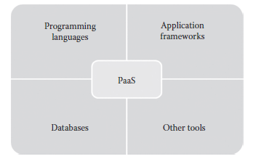
Jawaharlal Nehru Technological University – Jagityal (JNTU –J)
Platform as a Service(PaaS)
a) 4- basic services of PaaS:-
PaaS provides 4 basic services to end-user
    Programming Tools
    Application Frameworks
    Databases
    Other Tools as a Services
Cloud Computing – Cloud Services – Unit-IV

Slide 42
Jawaharlal Nehru Technological University – Jagityal (JNTU –J)
Platform as a Service(PaaS)
    Programming Tools:-
    PaaS provides support for a variety of programming tools to support for development of application
      C, C++
      Java
      PERL, PHP, Python
      Ruby, Scala
      Clojure and GO
Cloud Computing – Cloud Services – Unit-IV

Slide 43
Jawaharlal Nehru Technological University – Jagityal (JNTU –J)
Platform as a Service(PaaS)
    Application Frameworks:-
    PaaS provides support for a variety of frameworks for quick development of application
      Springs, Rails, Play
      Drupal, Joomla, Word Press, Node.js
      Django, EE6
      Rack and Zend
Cloud Computing – Cloud Services – Unit-IV

Slide 44
Jawaharlal Nehru Technological University – Jagityal (JNTU –J)
Platform as a Service(PaaS)
    Databases :-
    PaaS provides support for a variety of databases for quick development of application
      Oracle Database, Azure DB, Google cloud DB
      Mongo DB, Clear DB, Mambase
      MySQL, PostgreSQL, Redis
      Cloudant and many other
Cloud Computing – Cloud Services – Unit-IV

Slide 45
Jawaharlal Nehru Technological University – Jagityal (JNTU –J)
Platform as a Service(PaaS)
    Other Tools:-
    PaaS provides support for a variety of other tools for quick development of application
        Debugging tools
        Testing tools
        Deployment tools
        Maintenance tools
        Planning tools
        Communication tools
Cloud Computing – Cloud Services – Unit-IV

Slide 46
Jawaharlal Nehru Technological University – Jagityal (JNTU –J)
Platform as a Service(PaaS)
    Other Tools:-
    PaaS provides support for a variety other tools for quick development of application
        Debugging tools
        Testing tools
        Deployment tools
        Maintenance tools
        Planning tools
        Communication tools
Cloud Computing – Cloud Services – Unit-IV

Slide 47
Jawaharlal Nehru Technological University – Jagityal (JNTU –J)
Platform as a Service(PaaS)
    b) Characeristics of PaaS:-
    PaaS has its own characteristics in addition to the 5-essential characteristics of the cloud
        All-in-one
        Web Acces to the Platform
        Offline Access
        Built-in-Scalability
        Collaborative Platform
        Diverse Client Tools
Cloud Computing – Cloud Services – Unit-IV

Slide 48
Jawaharlal Nehru Technological University – Jagityal (JNTU –J)
Platform as a Service(PaaS)
    c) Suitability of PaaS:-
    Many Startup SaaS companies and ISVs are opting
    Software Development Companies are also opting
    PaaS eventhough, it provides lot of benefits to the user and the organization, it can and can’t be used at some places
Cloud Computing – Cloud Services – Unit-IV

Slide 49
Jawaharlal Nehru Technological University – Jagityal (JNTU –J)
Platform as a Service(PaaS)
    c) Suitability of PaaS:-
    Places where PaaS is suitable:
        Collaborative Development
        Automated Testing and Deployment
        Time to Market
Cloud Computing – Cloud Services – Unit-IV

Slide 50
Jawaharlal Nehru Technological University – Jagityal (JNTU –J)
Platform as a Service(PaaS)
    c) Suitability of PaaS:-
    Places where PaaS is not suitable:
        Frequent Application Migration
        Control over Physical Infrastructure is needed
        Flexibility on Development Platform
        Integration with On-Premise Application
Cloud Computing – Cloud Services – Unit-IV

Slide 51
Jawaharlal Nehru Technological University – Jagityal (JNTU –J)
Platform as a Service(PaaS)
    d) Pros and Cons of PaaS:-
    PaaS, even though provides lot of benefits to the organizations by saving its money and reducing its TCO and increasing its productivity, it is having advantages and disadvantages
Cloud Computing – Cloud Services – Unit-IV

Slide 52
Jawaharlal Nehru Technological University – Jagityal (JNTU –J)
Platform as a Service(PaaS)
    d) Pros and Cons of PaaS:-
    Advantages:-
        Quick Application Development & Deployment
        Reduced TCO
        Support for Agile Development Methodology
        Different Teams can Work at a Time
        Ease of Use of Platform
        Less Maintenance Overhead
        Produces Scable Applications
Cloud Computing – Cloud Services – Unit-IV

Slide 53
Jawaharlal Nehru Technological University – Jagityal (JNTU –J)
Platform as a Service(PaaS)
    d) Pros and Cons of PaaS:-
    Disadvantages:-
        Vendor Lock-in Issues
        Security Issues
        Less Flexibility
        Depends on Internet Connection
Cloud Computing – Cloud Services – Unit-IV

Slide 54
Jawaharlal Nehru Technological University – Jagityal (JNTU –J)
Platform as a Service(PaaS)
    e) PaaS providers:-
    Many PaaS providers are available in the market.
    PaaS Services offered using any of 4 deployment models
    User can select any one of the serivice providers based on their requirement and support given by the provider
Cloud Computing – Cloud Services – Unit-IV

Slide 55
Jawaharlal Nehru Technological University – Jagityal (JNTU –J)
Platform as a Service(PaaS)
    e) PaaS providers:-
    Service providers details are viewed in terms of
        License
        Deployment model
        Programming Tools Support
        Databases Support
        Application Framework Support
        User Interface
Cloud Computing – Cloud Services – Unit-IV

Slide 56
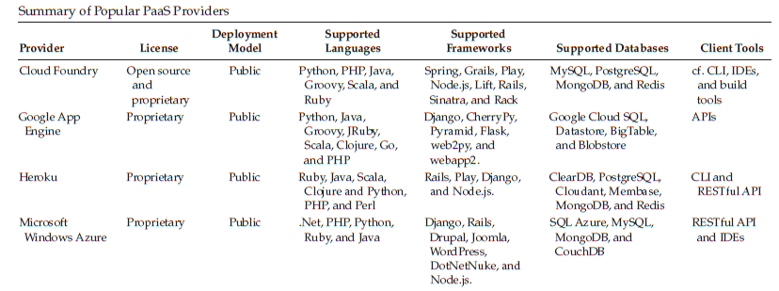
Jawaharlal Nehru Technological University – Jagityal (JNTU –J)
Platform as a Service(PaaS)
    e) PaaS providers:-
    Service providers list
Cloud Computing – Cloud Services – Unit-IV

Slide 57
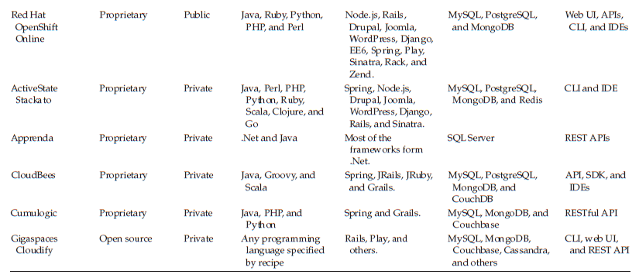
Jawaharlal Nehru Technological University – Jagityal (JNTU –J)
Software as a Service(SaaS)
    e) PaaS providers:-
    Service providers list continued...
Cloud Computing – Cloud Services – Unit-IV

Slide 58
Jawaharlal Nehru Technological University – Jagityal (JNTU –J)
Software as a Service(SaaS)
Cloud Computing – Cloud Services – Unit-IV

Slide 59
Jawaharlal Nehru Technological University – Jagityal (JNTU –J)
Software as a Service(SaaS)
Cloud-SaaS provides its own software as a service to the user
Varieties of software are offered as service
Target end-users are users who have little knowledge on computers
Cloud-SaaS is completely different from Traditional IT environment
Cloud Computing – Cloud Services – Unit-IV

Slide 60
Jawaharlal Nehru Technological University – Jagityal (JNTU –J)
Software as a Service(SaaS)
Traditional IT software environment
    Software need to be purchased
    Software need to be installed on stand-alone system
    Software need to be maintained
    One user can work at a time
    Online access is not possible
    Software need to be maintained
Cloud Computing – Cloud Services – Unit-IV

Slide 61
Jawaharlal Nehru Technological University – Jagityal (JNTU –J)
Software as a Service(SaaS)
In a Cloud-SaaS
    Many software are offered
    Many users can access services at a time
    Online web access is possible
    Software can be accessed at any time, from any place and by any device
    It saves lot of investment to the organizations and ISVs
Cloud Computing – Cloud Services – Unit-IV

Slide 62
Jawaharlal Nehru Technological University – Jagityal (JNTU –J)
Software as a Service(SaaS)
In a Cloud-SaaS
    It can be accessed from a lower-configure system with a browser
    Rarely used software can also be accessed
    End-ser is exempted from resource maintenance, OS installations, configuring platform, etc.
Cloud Computing – Cloud Services – Unit-IV

Slide 63
Jawaharlal Nehru Technological University – Jagityal (JNTU –J)
Software as a Service(SaaS)
4- basic services of SaaS:-
SaaS provides 4 basic services to end-user
    Business Services
    Documents Management Services
    Mail Services
    Social Network Services
Cloud Computing – Cloud Services – Unit-IV

Slide 64
Jawaharlal Nehru Technological University – Jagityal (JNTU –J)
Software as a Service(SaaS)
    Business Services:-
    SaaS provides support for a variety of software to support regular business activities
      CRM, ERP software
      Sales, Billing, Advertisement software
Cloud Computing – Cloud Services – Unit-IV

Slide 65
Jawaharlal Nehru Technological University – Jagityal (JNTU –J)
Software as a Service(SaaS)
    Document Management Service:-
    Most organizations today maintaining electronic documents
    SaaS provides software to support for creating, storing, retrieving and maintaining documents
Cloud Computing – Cloud Services – Unit-IV

Slide 66
Jawaharlal Nehru Technological University – Jagityal (JNTU –J)
Software as a Service(SaaS)
    E-Mail Services:-
    SaaS provides support for a electronic mail software used by general people
    The service require lot of storage space & servers hence SaaS is best service
Cloud Computing – Cloud Services – Unit-IV

Slide 67
Jawaharlal Nehru Technological University – Jagityal (JNTU –J)
Software as a Service(SaaS)
    Social Network Service:-
    SaaS provides support for social networking software used by general people
    The service require lot of storage space & servers hence SaaS is best service
Cloud Computing – Cloud Services – Unit-IV

Slide 68
Jawaharlal Nehru Technological University – Jagityal (JNTU –J)
Software as a Service(SaaS)
    b) Characteristics of SaaS:-
    SaaS has its own characteristics in addition to the 5-essential characteristics of the cloud
        One-to-many Model
        Web Access to the Software
        API integration
        Better Scalability
Cloud Computing – Cloud Services – Unit-IV

Slide 69
Jawaharlal Nehru Technological University – Jagityal (JNTU –J)
Software as a Service(SaaS)
    b) Characteristics of SaaS:-
    SaaS has its own characteristics in addition to the 5-essential characteristics of the cloud
        Centralized Control/Management
        High Availability
        Multiple Device Support
Cloud Computing – Cloud Services – Unit-IV

Slide 70
Jawaharlal Nehru Technological University – Jagityal (JNTU –J)
Software as a Service(SaaS)
    c) Suitability of SaaS:-
    Many Startup-companies and ISVs are opting
    Software Companies are also opting
    SaaS even though, it provides lot of benefits to the user and the organization, it can and can’t be used at some places
Cloud Computing – Cloud Services – Unit-IV

Slide 71
Jawaharlal Nehru Technological University – Jagityal (JNTU –J)
Software as a Service(SaaS)
    c) Suitability of SaaS:-
    Places where SaaS is suitable:
        Software for Start-up Companies
        On-Demand Software
        Software with variable loads
        Software with multiple Device Support
Cloud Computing – Cloud Services – Unit-IV

Slide 72
Jawaharlal Nehru Technological University – Jagityal (JNTU –J)
Software as a Service(SaaS)
    c) Suitability of SaaS:-
    Places where SaaS is not suitable:
        Real Time Applications
        Applications Working with Confidential Data
        Better on-premise Applications
Cloud Computing – Cloud Services – Unit-IV

Slide 73
Jawaharlal Nehru Technological University – Jagityal (JNTU –J)
Software as a Service(SaaS)
    d) Pros and Cons of PaaS:-
    SaaS, even though provides lot of benefits to the organizations by saving its money and reducing its TCO and increasing its productivity, it is having advantages and disadvantages
Cloud Computing – Cloud Services – Unit-IV

Slide 74
Jawaharlal Nehru Technological University – Jagityal (JNTU –J)
Software as a Service(SaaS)
    d) Pros and Cons of SaaS:-
    Advantages:-
        No Client-side Installation
        Cost Saving
        Less Maintenance
        Ease of Access
        Dynamic Scaling
        Disaster Recovery
        Multitenancy
Cloud Computing – Cloud Services – Unit-IV

Slide 75
Jawaharlal Nehru Technological University – Jagityal (JNTU –J)
Software as a Service(SaaS)
    d) Pros and Cons of SaaS:-
    Disadvantages:-
        Security Issues
        Loss of data control
        Depends on Internet Connection
Cloud Computing – Cloud Services – Unit-IV

Slide 76
Jawaharlal Nehru Technological University – Jagityal (JNTU –J)
Software as a Service(SaaS)
    e) PaaS providers:-
    Many SaaS providers are available in the market.
    SaaS Services offered using any of 4 deployment models
    User can select any one of the service providers based on their requirement and support given by the provider
Cloud Computing – Cloud Services – Unit-IV

Slide 77
Jawaharlal Nehru Technological University – Jagityal (JNTU –J)
Software as a Service(SaaS)
    e) SaaS providers:-
    Service providers details are viewed in terms of
        Software Purpose
        Services Provided by the software
Cloud Computing – Cloud Services – Unit-IV

Slide 78
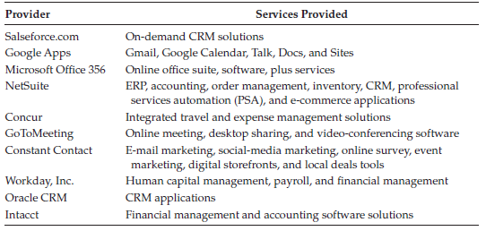
Jawaharlal Nehru Technological University – Jagityal (JNTU –J)
Software as a Service(SaaS)
    e) SaaS providers:-
    Service providers
Cloud Computing – Cloud Services – Unit-IV

Slide 79
Jawaharlal Nehru Technological University – Jagityal (JNTU –J)
Other Service
Cloud Computing – Cloud Services – Unit-IV

Slide 80
Jawaharlal Nehru Technological University – Jagityal (JNTU –J)
Other Services
In addition to the IaaS, PaaS and SaaS services, cloud also provides the following services
    Storage as a Service (STaaS)
    Data Base as a Service (DBaaS)
    Network as a Service (NaaS)
    SEcurity as a Service (SEaaS)
    Identity as a Service (IDaaS)
    Data as a Service (DaaS)
Cloud Computing – Cloud Services – Unit-IV

Slide 81

Jawaharlal Nehru Technological University – Jagityal (JNTU –J)
Cloud Computing – Cloud Services – Unit-IV

Slide 82

Jawaharlal Nehru Technological University – Jagityal (JNTU –J)
Cloud Computing – Cloud Services – Unit-IV

